Slide 1
Deep Desciptor Transforming

Slide 2
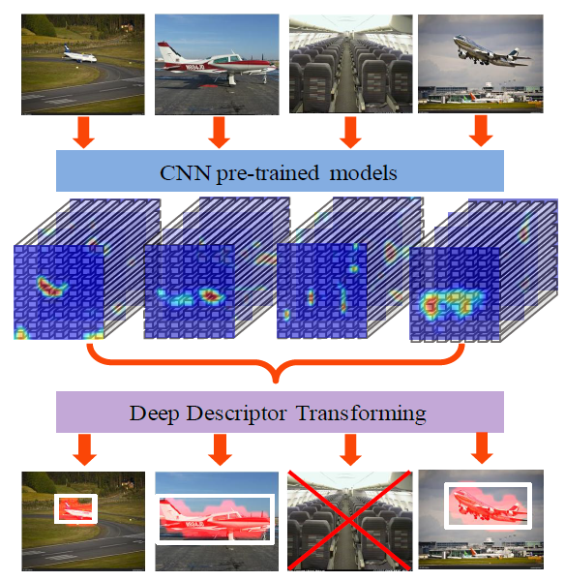

Slide 3
Notations
Feature map: the convolution results of one channel
Activations: feature maps of all channels in a convolution layer
Descriptor: the d-dimensional component vector of activations

Slide 4
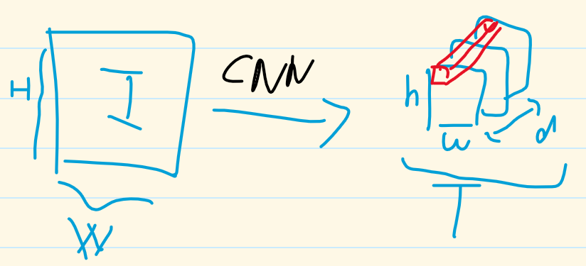

Slide 5
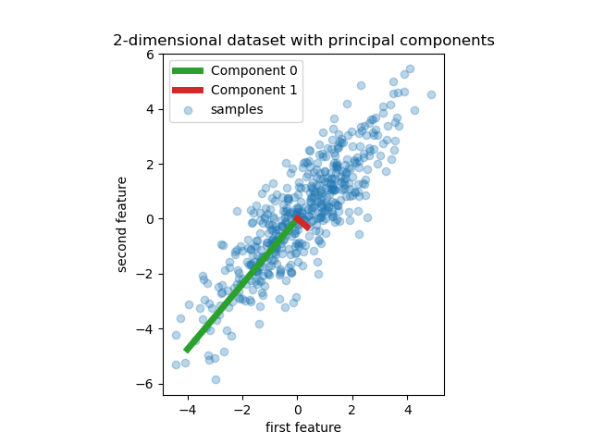
PCA示意圖

Slide 6
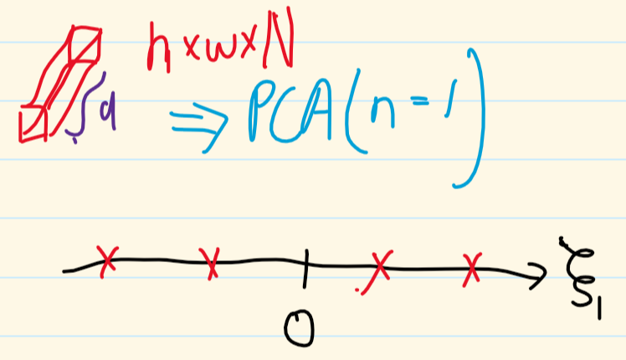

Slide 7
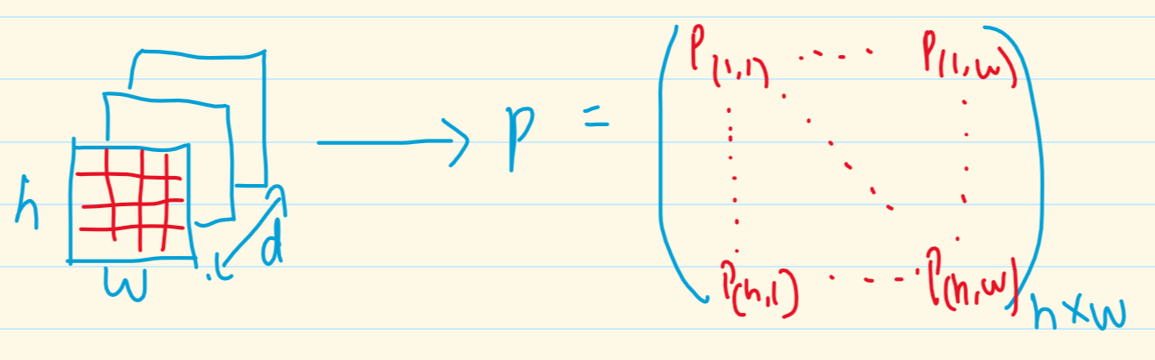
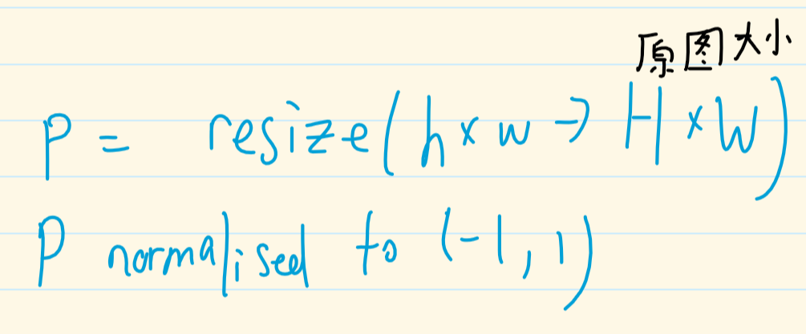

Slide 8
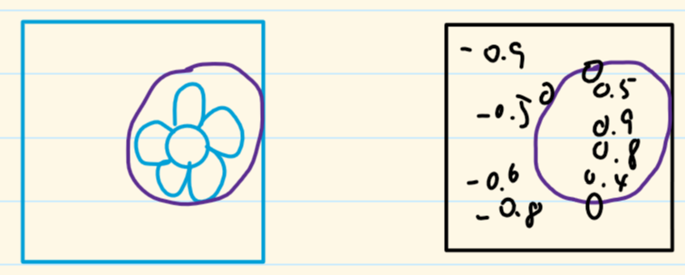

Slide 9
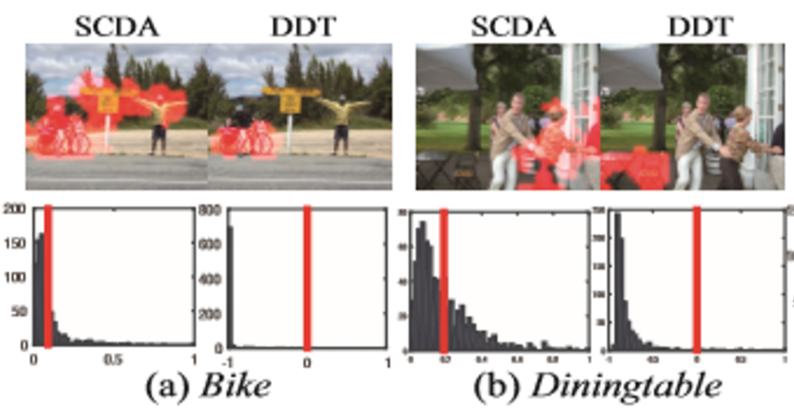

Slide 10
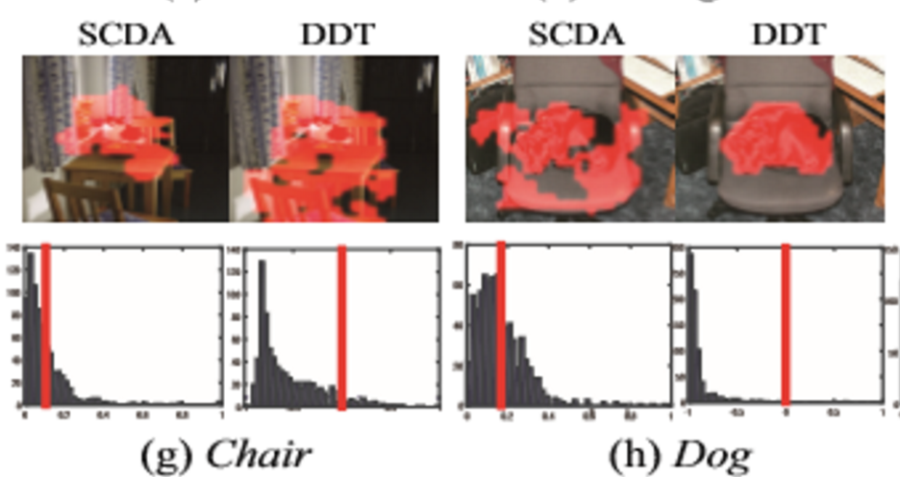

Slide 11
Code
Using 17 category flowers datasets
Import VGG16 as feature extractor

